Slide 1

In Higher Education Institutions:
an Introduction
David J. Lock
Secretary General
Magna Charta Observatory

Slide 2

Agenda
Introduction to the Workshop
A brief history of the project
The project
The benefits/outcomes
Critical Success Factors
What happens next
  For universities
  For the Magna Charta Observatory
Questions

Slide 3
Introduction to the Workshop

Slide 4
Aim of the meeting
To review and support the progress of the pilots
to share approaches to the use of the guidelines
to evaluate the effectiveness and any limitations of each, the reasons leading to these and what might be done differently
to share findings regarding values and their implementation to date
to share observations on the guidelines themselves and how they might be improved
to agree arrangements for the remainder of the pilot and
to give preliminary consideration to the presentation in Bologna

Slide 5
Programme
Flexible and adaptable but:
  Introduction
  Meetings between pilots and ambassadors re progress
  Plenary review of experience and issues
  Groups focus on values and how they have impact
  Plenary sharing
  Meetings between pilots and ambassadors re next steps
  Plenary re next steps, expectations and sharing

Slide 6
A brief history of the project

Slide 7
A Brief History
MCU 1988 and role of MCO
“Fundamental Values”
Higher Education – challenges
MCO Strategy 2015 -2020
  Global
  Closer engagement with signatories
  Ambassadors
Regional workshops – rich findings on context and values – espousing values no longer sufficient
Living Values Project evolves

Slide 8
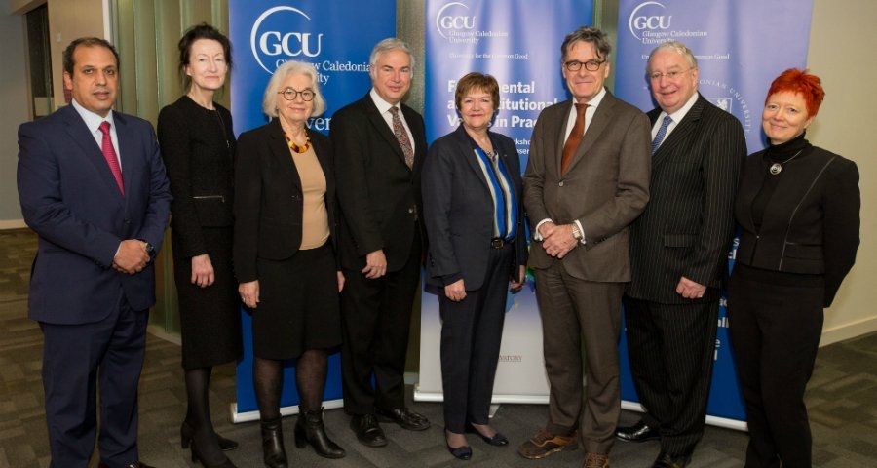
The Project
Understanding values – Ambassadors
Glasgow Workshop
Production of Guidelines
Pilot sites*
Piloting
Bologna Workshop
Reports
Prospectus, Guidelines and Resources

Slide 9

Global scope:2018
Stockholms Universitet (Sweden)
Peoples' Friendship University of Russia
Glasgow Caledonian University (UK)
The University of Tasmania (Australia)
Cardiff Metropolitan University (UK)
University Politehnica of Bucharest (Romania)
The University of Bologna (Italy)
Universidade Estadual de Campinas - UNICAMP (Brazil)
The Arab Academy for Science, Technology and Maritime Transport (Egypt)
University of Mauritius

Slide 10
Global scope:2019
Newcastle University
(U.K.)
Alma Mater Europaea
(Slovenia)
O.M.Beketov National University of Urban Economy in Kharkiv
(Ukraine)
University of
Winchester (U.K.)
Università degli Studi di Torino (Italy)
Ilia State University
(Georgia)
Boris Grinchenko
Kyiv University (Ukraine)
Siam University (Thailand)
Università degli Studi di Genova (Italy)
Daffodil International University of Bangladesh
Universidade Católica de Angola

Slide 11
Global scope to date
Alma Mater Europaea
(Slovenia)
Stockholms Universitet (Sweden)
Boris Grinchenko
Kyiv University (Ukraine)
Peoples' Friendship University of Russia
O.M.Beketov National University of Urban Economy in Kharkiv
(Ukraine)
Glasgow Caledonian University (UK)
Newcastle University
(U.K.)
Ilia State University
(Georgia)
Cardiff Metropolitan University (UK)
Daffodil International University of Bangladesh
University of
Winchester (U.K.)
Siam University (Thailand)
Università degli Studi di Torino (Italy)
The University of Tasmania (Australia)
Università degli Studi di Genova (Italy)
Universidade Estadual de Campinas - UNICAMP (Brazil)
The Arab Academy for Science, Technology and Maritime Transport (Egypt)
University Politehnica of Bucharest (Romania)
The University of Bologna (Italy)
Universidade Católica de Angola
University of Mauritius

Slide 12
The Project

Slide 13
The Project
Understanding values – Ambassadors
Glasgow Workshop
Production of Guidelines
Pilot sites
Ambassadors
Piloting
Bologna Workshop
Reports
Prospectus, Guidelines and Resources

Slide 14
Project Objectives
To help universities and higher education institutions ensure that:
the values they espouse reflect the institution’s mission and community;
staff, students, and stakeholders have been effectively engaged in defining those values; and
all members of the institution are able to articulate and effectively live by these defined values

Slide 15
Means of achieving the objectives
To do so in a way that is:
Open to all universities
Web-based with additional support
Developmental (learning from experience)
Via:
Prospectus
Guidelines
Sharing experience
  On-line
  In person/workshops/etc

Slide 16
Values
Fundamental
  academic freedom,
  institutional autonomy, and
  the concomitant responsibility to society.
Other values may include:
  integrity and fairness;
  equity;
  creativity, innovativeness;
  excellence;
  social responsibility and community service;
  diversity, pluralism, and inclusiveness, and
  health, well-being, and a caring community.

Slide 17
Stages of the process
Initiation and plan
Identification of a map of values
Define how selected values manifest in practice
Relate behaviours to functions/domains
Conversion of values into desired behaviour
Conversion of outcomes into strategic plan and other policies
Reflection on the process, effectiveness and next cycle.

Slide 18
Project Benefits and Outcomes

Slide 19
Project Benefits- for universities
Unique for each institution
Depends on:
  starting point/circumstances/objectives
Ultimately:
  enhanced performance in T&L, R, Service to the Community
  More engaged staff/stronger community
  More understanding/engaged stakeholders

Slide 20
Project Benefits- pilot sites (1)
an evaluation of current and desired values,
  the extent to which they are relevant and
  are put into practice,
  how they might enhance
    what the university does and
    how it does it;
identifying where there might be a gap between
  the values espoused and
  their actual implementation and
  how they might be more effectively and beneficially implemented;
Greater authenticity and enhanced reputation of university;

Slide 21
Project Benefits- pilot sites (2)
an externally facilitated opportunity to reflect on institutional culture and ethos as exemplified by its value system;
an opportunity to
  build and strengthen the academic community and
  its engagement within the university as a whole, leading to
  an enhanced appreciation of an institution’s values and mission
  stimulate innovation and commitment,
  leading to improved performance in teaching, research, and
  service to the community;

Slide 22
Project Benefits- pilot sites (3)
an opportunity to engage with external stakeholders, communicate the values and mission, and strengthen engagement;
identification and removal of barriers to the realisation of an institution’s values;
a closer alignment of individual and institutional values;
enhanced social engagement and building of trust, internally with staff and students and externally with stakeholders.

Slide 23
Project Benefits- specifics
Values-basis for institutional governance
Values-basis for strategic plan
Re-prioritisation of values
Values included in student induction
Values included in staff recruitment and induction
Improved ‘satisfaction and well-being’
Others?

Slide 24
Critical Success Factors

Slide 25
Critical success factors (1):
engagement of relevant stakeholders, internal and external, and their agreement on the need for, design, and execution of the initiative, which creates clear and legitimised ownership and commitment;
leadership from the top of the university and buy-in of leaders at various levels;
a bottom-up process, including a clear and agreed upon framework and two-way honest and frank communication between those leading and those contributing;

Slide 26
Critical success factors (2):
a well-managed process with a competent leader;
a limited number of critical values;
a robust but achievable timescale;
a well-informed process supported by accurate and relevant data;
a goal of achieving maximum impact, with the understanding that developing and living values is a continuous, iterative, and interactive process
embedding the learning in practice.

Slide 27
Benefits for MCO include:-
research on how values can have impact for universities;
improving understanding of situational variables;
enhancing the MCO’s intelligence and advising capacity;
enhancing the quality and range of services to signatories;
disseminating publications, including case studies of good practice, at conferences and workshops;
further developing the Living Values tools and guidelines in the light of insights gained from using them;
supporting Ambassadors as advisers and consultants in institutional value development;
Informing review of MCU and
More useful website.

Slide 32
What happens next: pilots
Work in progress…….
  Complete the piloting activity
  Liaison with Ambassadors
  Bologna workshop to review and develop activity
  Share findings with MCO community via web
  Reports
  Presentation in Bologna September 2020

Slide 33
What happens next: MCO
Regional workshops - hosts/partners invited
Consultancy service
Grow Ambassador team
Research into values
Revision of MCO
Share at other conferences (IAU etc.)
Feature in 2019 and 2020 Anniversary

Slide 34
http://www.magna-charta.org/activities-and-projects/living-values-project
Reaction and evidence from Pilot sites
Questions
Discussion

